Slide 1

Introduction to Algorithms
Algorithms are fundamental building blocks of computer science, providing step-by-step procedures to solve complex problems efficiently. They form the core of software development, enabling the creation of innovative applications that power the digital world.

Slide 2
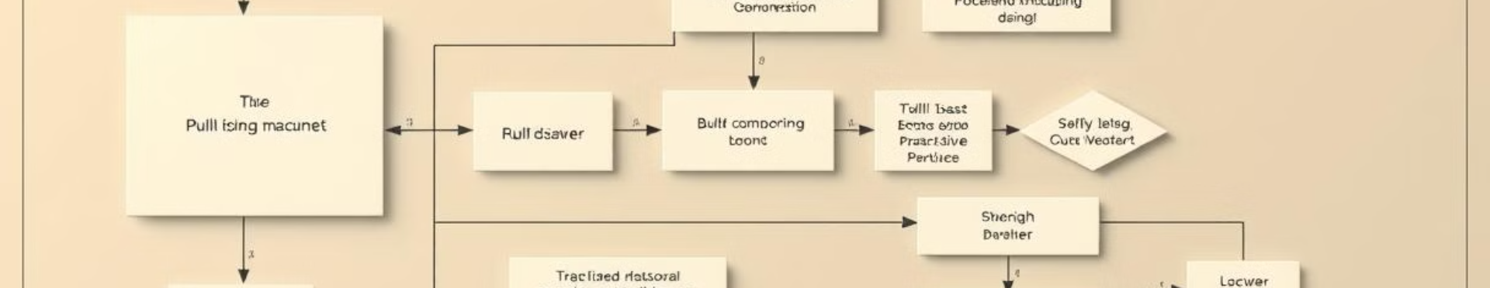
What are Algorithms?
1
Logical Steps
2
Problem Solving
3
Efficiency
Algorithms are well-defined sequences of instructions that guide computers to perform specific tasks.
Algorithms break down complex problems into smaller, manageable steps to find solutions.
Algorithms aim to optimize the use of resources, such as time and memory, to solve problems.

Slide 3
Importance of Algorithms
Fundamental to Computing
Optimization and Efficiency
Everyday Applications
Algorithms are the foundation of all computer programs and software applications.
Algorithms help improve the performance and resource utilization of computer systems.
Algorithms power a wide range of everyday technologies, from search engines to recommendation systems.

Slide 4

Algorithm Analysis
1
Time Complexity
The measure of how long an algorithm takes to run as a function of the input size.
2
Space Complexity
The measure of how much memory an algorithm requires to run as a function of the input size.
3
Asymptotic Analysis
The study of how algorithms scale as the input size grows, using Big O notation.

Slide 5

Basic Algorithmic Strategies
Divide and Conquer
Greedy Approach
Breaking a problem into smaller subproblems, solving them independently, and combining the results.
Making locally optimal choices at each step with the hope of finding a global optimum.
Dynamic Programming
Brute Force
Solving complex problems by breaking them down into smaller, overlapping subproblems.
Systematically enumerating all possible candidates for the solution and checking if each candidate satisfies the problem's statement.

Slide 6




Sorting Algorithms
Bubble Sort
A simple sorting algorithm that repeatedly steps through the list, compares adjacent elements, and swaps them if they are in the wrong order.
Merge Sort
A divide-and-conquer algorithm that recursively breaks down the input array into smaller subarrays until they can be merged back together in sorted order.
Quicksort
A popular sorting algorithm that uses a divide-and-conquer strategy to partition the input array around a selected pivot element.

Slide 7




Searching Algorithms
Linear Search
A simple algorithm that sequentially checks each element in a data structure until the target element is found or the end is reached.
Binary Search
An efficient algorithm for finding the position of a target value within a sorted array, by repeatedly dividing the search interval in half.
Hash Table Search
A search technique that uses a hash function to quickly locate data in a data structure, providing constant-time average-case performance.

Slide 8

Applications of Algorithms
Web Search
Recommendation Systems
Cryptography
Routing and Navigation
Data Compression
Machine Learning
Bioinformatics
Scheduling and Optimization

